Slide 2

Ravichander Rajendran
Enterprise Information Architecture Lead
AstraZeneca

Slide 3
A Data FAIRy Tale
Unveiling the need for strong data foundation..

Slide 4

Once upon a time….
In the data world, people lived happily….
Reports
Structured data
OLAP
RDBMS
ETL, Data Marts
OLTP

Slide 5



Over the time, people got blessed with 3 superpowers..
Big Data
Compute
Storage

Slide 6





Some impacts of super-powers..
By 2025, 49% of all data worldwide will reside in public cloud environments
2237+
File formats
available
Approx 42 GB data created by each of us annually
Estimated
178 ZB of data will be generated annually in 2025*
iPhone 15
35 trillion operations per second

Slide 7

With great powers, comes magical outcomes..
Cloud Computing
Artificial Intelligence
NoSQL Databases
Machine Learning
Real-time Decision Making
& many more…
But….

Slide 8




It has a dark side too..
90% of the existing data is replicated
91% are concerned about cloud security
95% of business feels challenging on processing unstructured data
$4.77M cost/loss when hackers break in the security

Slide 9






As evil data forces rises,
We need a saviour..
Growing Data
V
s
Poor Data Quality
Poor Interoperability
Data Foundation
Security & Privacy Concerns

Slide 10


We also need specialized weapons..
Data Modelling
Data Quality
Data Integration &
Interoperability
Master & Reference
Data
Metadata
Data Governance
Data Storage,
Operations & Security
Data Architecture

Slide 11

We have a magic potion too…
F A I R
indable
ccessible
nteroperable
eusable
Once the user finds the required data, she/he/they need to know how they can be accessed.
The data usually need to be integrated with other data.
The goal of FAIR is to optimize the reuse of data.
The first step in (re)using data is to find them.

Slide 12
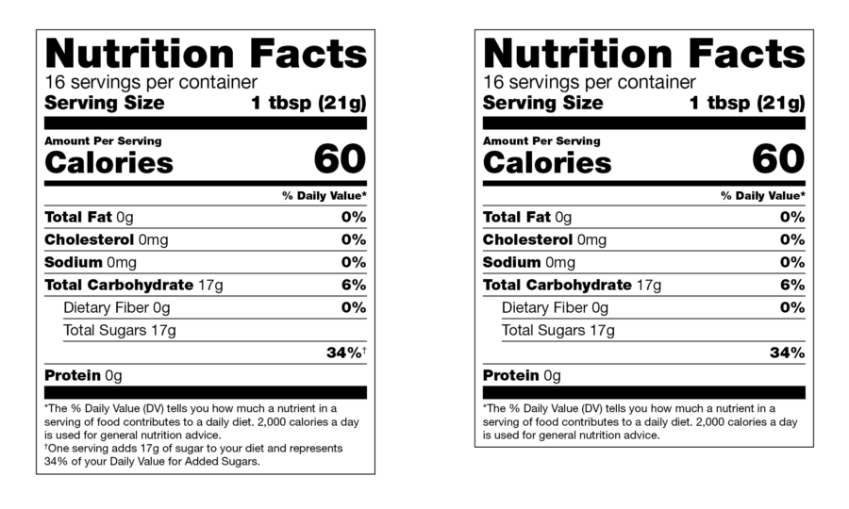




Metadata
Types of data..
Master Data
Honey
Water
Juice
Unique Identifier
Raw
Processed
Still
Sparkling
Vegetable
Fruit
Reference Data
Transactional Data

Slide 13
FAIR principles
Meta(data) should have/be
F1. (Meta)data are assigned a globally unique and persistent identifier
F2. Data are described with rich metadata
F3. Metadata clearly and explicitly include the identifier of the data they describe
F4. (Meta)data are registered or indexed in a searchable resource
Globally Unique & Persistent Identifiers
Terms of
Access
A1. (Meta)data are retrievable by their identifier using a standardised communications protocol
A2. Metadata are accessible, even when the data are no longer available
Terms of
Use
I1. (Meta)data use a formal, accessible, shared, and broadly applicable language for knowledge representation.
I2. (Meta)data use vocabularies that follow FAIR principles
I3. (Meta)data include qualified references to other (meta)data
Community defined
Terminologies
and descriptive metadata
Detailed
Provenance
R1. (Meta)data are richly described with a plurality of accurate and relevant attributes

Slide 14

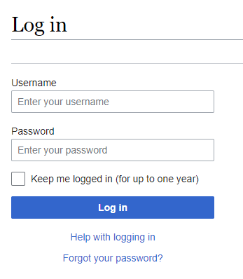
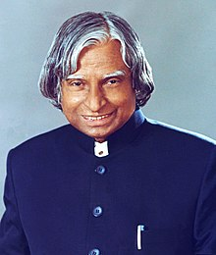

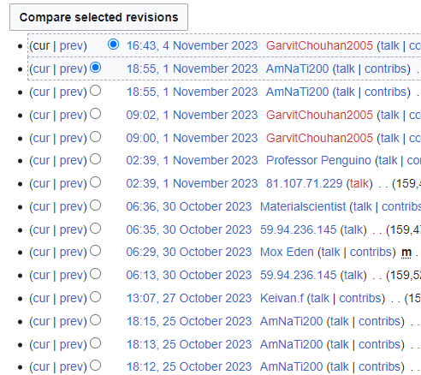
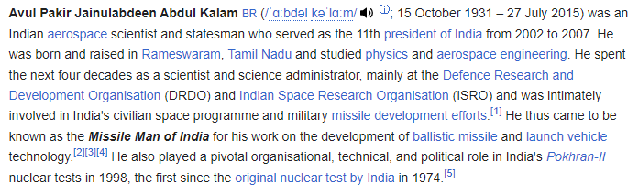

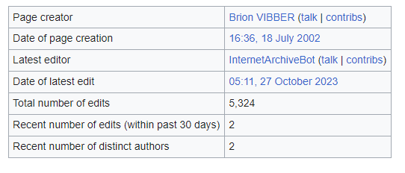
https://en.wikipedia.org/wiki/A._P._J._Abdul_Kalam
Protocol
Persistent Unique Identifier
Searchable Resource
Access Control
API Features
Rich Metadata
Standard References

Slide 15
FAIR Maturity Levels
Evolution of System Centric Thinking
Data Centric to Knowledge Centric Thinking
L1
L2
L3
L4
L5
L6
Data is catalogued in situ
Raw data in an unconformed format, external to a data lake
Requires expert technical and subject matter knowledge to access and use
Raw data catalogued and accessible with governance in a data lake, unconformed.
Requires average technical and expert subject matter knowledge to use
Conformed data catalogued and available in a data lake in accordance with industry standards
Data is conformed on a system-by-system basis and may not map to a domain data model
Controls on access at the system level
Requires average level technical and subject matter knowledge to use: Data Scientist.
Data conformed, integrated, processed and audited to support specific analytics patterns/enquiries
Data is conformed using a domain level data model
Data embeds local master and reference data
Controls on access at the data level
Creation of analytics ready 'Marts' enabling self-service analytics: Citizen Data Scientist
Extend L4 further by:
Data is described in a cross-domain data or industry model and is integrated in a Data Mesh
Data embeds enterprise master and reference data
Enterprise Metadata standard applied
URI’s and PURLs are implemented
Cross domain Analytics enabled: Citizen Data Scientist using all relevant data
Extend L5 further by:
Data is fully described using a knowledge language or ontology
Data is aggregated by business concepts and users can navigate from concept to concept
Automated AI enabled: AI and semantic solutions can act directly on data sets without need for interpretation
Knowledge enabled citizens

Slide 16













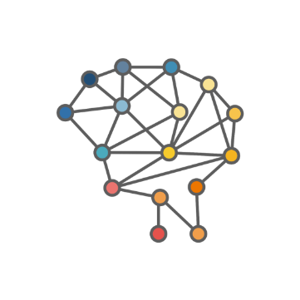
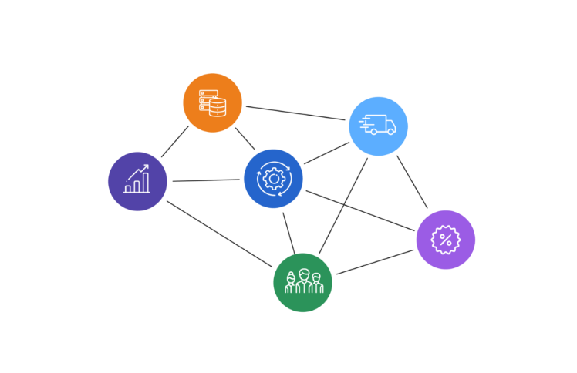



My PC
Data lake
Self-Service
Data Product
DATA
Raw
Standardized
C:\Users\rravi\Sales_Export_data.txt
/rravi/files/2023/11/18/Sales_Export_data.txt
Audited & Validated
Local Master & Reference Data
/sysdata/Sales/conformed/CSP_data_20231108.txt
Sales_Export_data.txt
1
File Path
Timestamps
File Path
System Level
Access
Domain-level Data Model
3
2
System Info
Company Sales Portal
Owner
Description
4
Data Catalogue
KNOWLEDGE
Persistent Identifiers
5
Enterprise Master & Reference Data
6
Data Fully Described
Discovery
Data as Reusable Asset
Aggregated by business concepts
Ontologies
Patterns
Knowledge Language
Machine
Actionability
Enterprise Metadata Standards
Reusability
Part of Data Mesh
INFORMATION

Slide 17





FAIR Working groups and projects..
Scan this QR code for links to F.A.I.R related resources

Slide 18
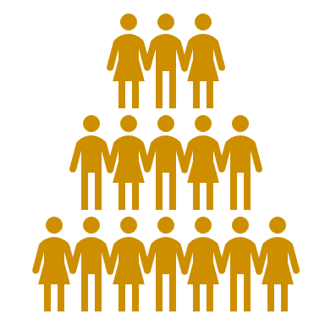
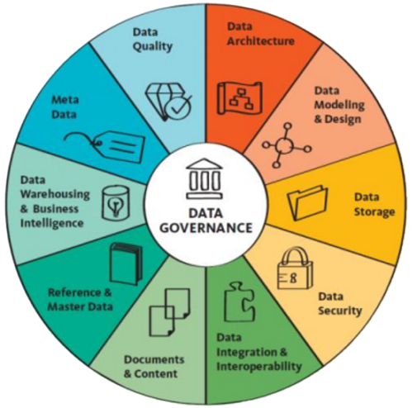




The Key message..
FAIR data
People
Data
Data Literacy
Process
Technology
The DAMA Wheel

Slide 19

The battle is still on..
Let’s join hands to fight the evil data forces…

Slide 20

Thank you for listening & it’s time for Q&A
A Data FAIRy Tale
Ravichander Rajendran
Enterprise Information Architecture Lead AstraZeneca

Slide 21







Gold Partner
Silver Partner

